Slide 1
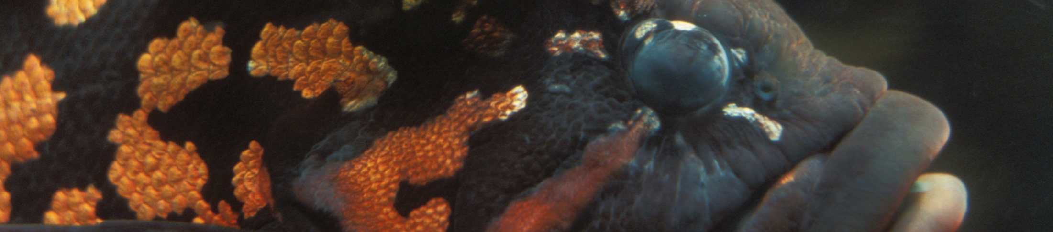


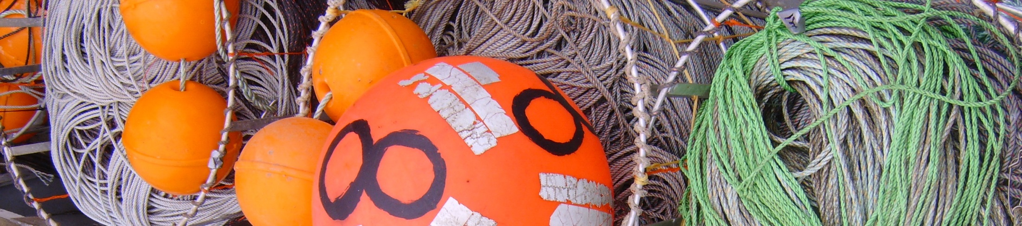
Overfishing and underfishing consequences for food security and economic value in U.S. fisheries
Michael Melnychuk, Jeannette Banobi, Ray Hilborn
School of Aquatic and Fishery Sciences
University of Washington

Slide 2
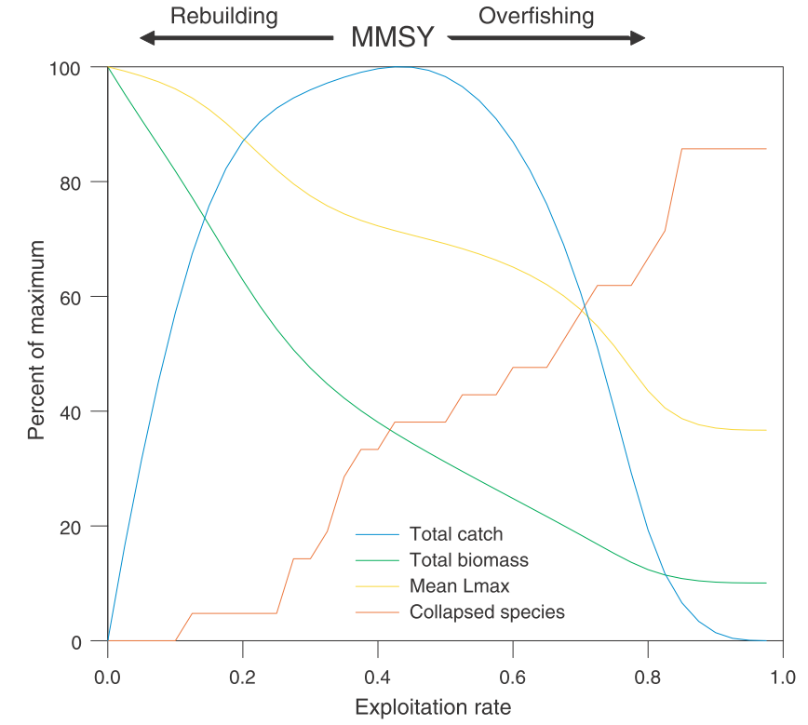
Georges Bank
Trade-offs
Worm et al. 2009,
Science
Notes:
Way to evaluate current stock status in relation to MSY – biological reference points

Slide 3
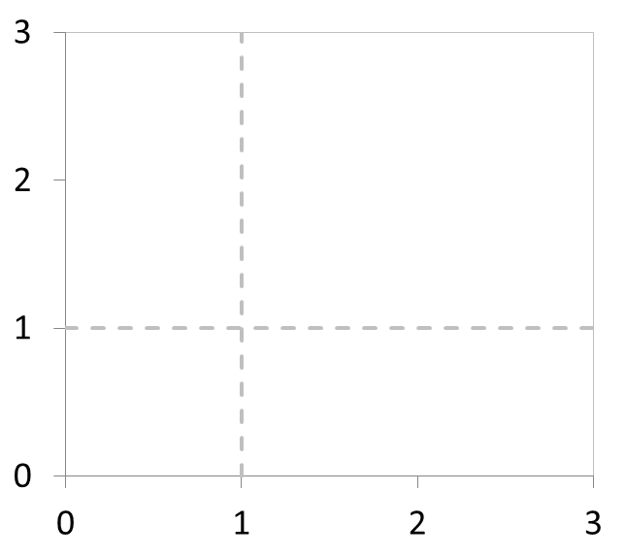
Biomass and fishing mortality reference points
Overfished
Overfishing
F/F_{MSY}
B/B_{MSY}
Notes:
What is the current status of US stocks?

Slide 4
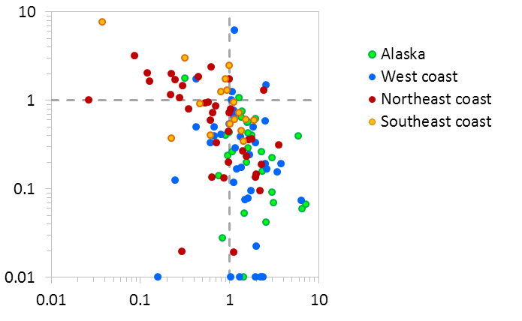
Recent status of U.S. stocks
F/F_{MSY}
Regional
medians
B/B_{MSY}
Notes:
How close are we to catching MSY?

Slide 5
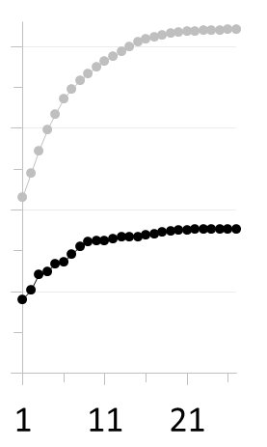
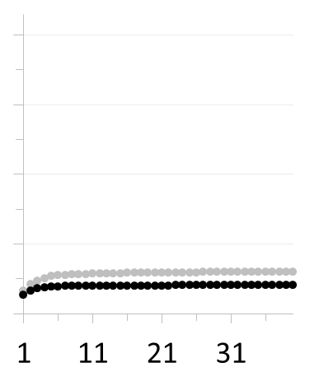
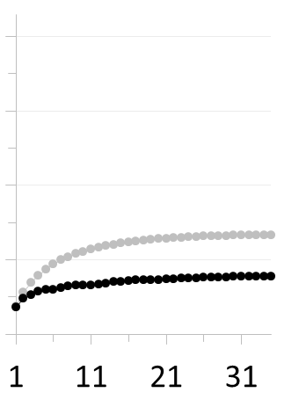
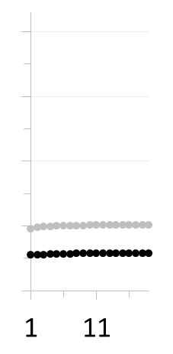
Cumulative multispecies yield
Maximum sustainable yield (MSY)
Equilibrium yield under current exploitation rate
Alaska
West coast
Northeast coast
Southeast
coast
4
3
2
1
0
Cumulative yield (millions t)
Foregone potential yield
(commercial landings only)
Rank order of stock MSY in region
Notes:
Relative contributions of various factors

Slide 6
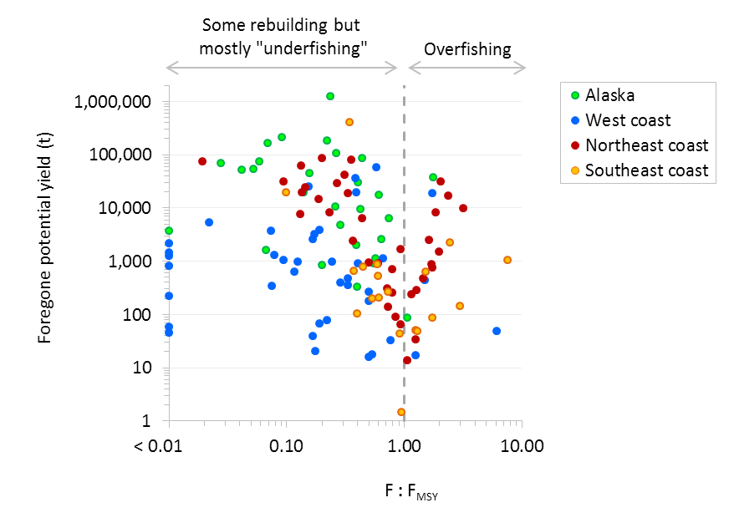
Foregone potential yield
∑ > 3.5 million t
∑ ≈ 0.15 million t
Notes:
Look at economic value

Slide 7
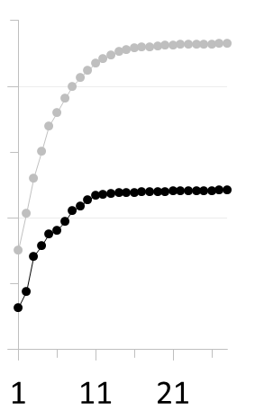
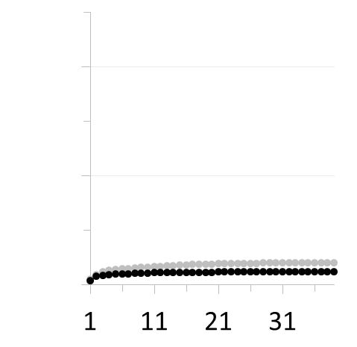
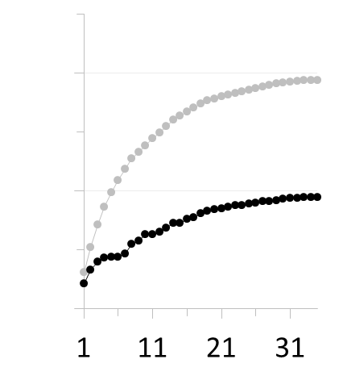
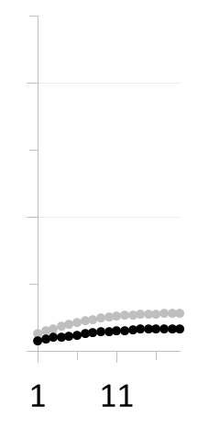
Cumulative multispecies landed value
Maximum sustainable landed value (MSLV)
Equilibrium landed value under current exploitation rate
Alaska
West coast
Northeast coast
Southeast
coast
2
1
0
Cumulative landed value ($billion)
Foregone potential landed value
(commercial landings only)
Rank order of stock MSLV in region
Notes:
How do overfishing and underfishing compare?

Slide 8
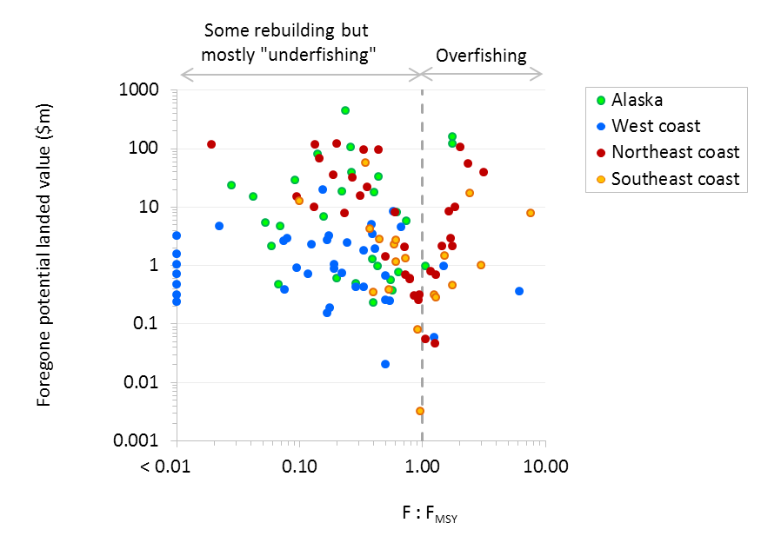
Foregone potential landed value
∑ > 1.7 billion $
∑ < 0.6 billion $
Notes:
Split into 2 groups, and for each group look at the effect that various factors have on the degree of over/underfishing

Slide 9
Factors affecting the degree of ‘underfishing’ or overfishing
Response
variable
Factors
Intercept
Ex-vessel price
Landings
Under rebuilding ?
Bycatch limits for exploited species ?
Bycatch limits for non-exploited species ?
Typically caught incidentally ?
Low market demand ?
Generalized
linear
mixed
effects
model
F/F_{MSY}
for stocks
experiencing
‘underfishing’
for stocks
experiencing
overfishing
{ Region = random effect }

Slide 10
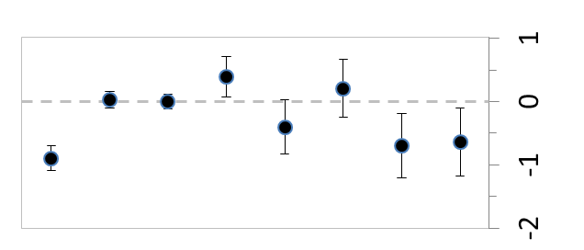
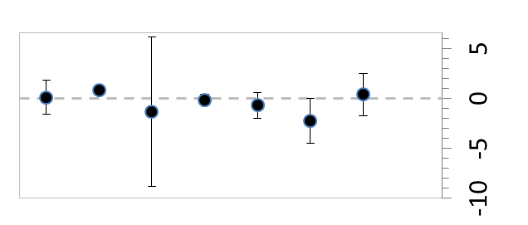
Factors affecting the degree of ‘underfishing’ or overfishing
Effect on F/F_{MSY} for stocks experiencing ‘underfishing’
Effect on F/F_{MSY} for stocks experiencing overfishing
Intercept
Ex-vessel price
Landings
Under rebuilding ?
Bycatch limits for exploited species ?
Bycatch limits for non-exploited species ?
Typically caught incidentally ?
Low market demand ?
*
*
*
*
no stocks
Coefficient estimate
Notes:
In thinking about trade-offs…

Slide 11
Underfishing /

Slide 12




Thank you to many fishery managers, stock assessment scientists, economists, social scientists, industry association representatives, and fishermen for patiently answering our questions.
And to all contributors to the RAM Legacy Stock Assessment Database
mmel@uw.edu

Slide 13
Recent status of U.S. stocks
SAC red snapper
OR cabezon
EC winter flounder
SAC snowy grouper
GoMaine cod
GoMex gag
Georges Bank cod
nWC lingcod
sNE yellowtail flounder
F/F_{MSY}
NE monkfish
5YZ Atlantic halibut
GoMex black grouper
GoA rex sole
WC bocaccio
WC English sole
GoA dover sole
BSAI Greenland turbot
BSAI flathead sole
GoA flathead sole
AI walleye pollock
Widow rockfish
NEC silver hake
Atlantic
butterfish
SWC rockfish: chilipepper, shortbelly, splitnose, greenstriped, blackgill, greenspotted
SWC cowcod
B/B_{MSY}
Notes:
How close are we to catching MSY?

Slide 14
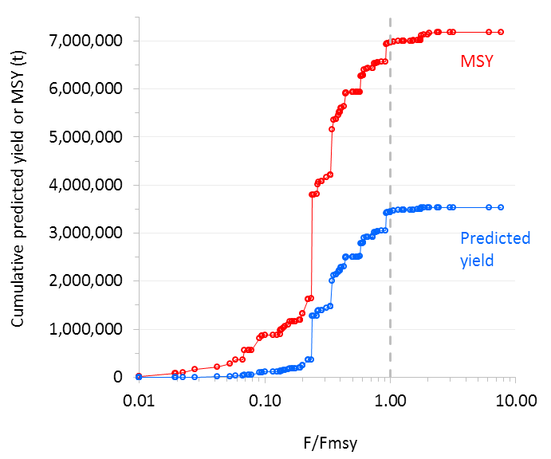
Equilibrium

Slide 15
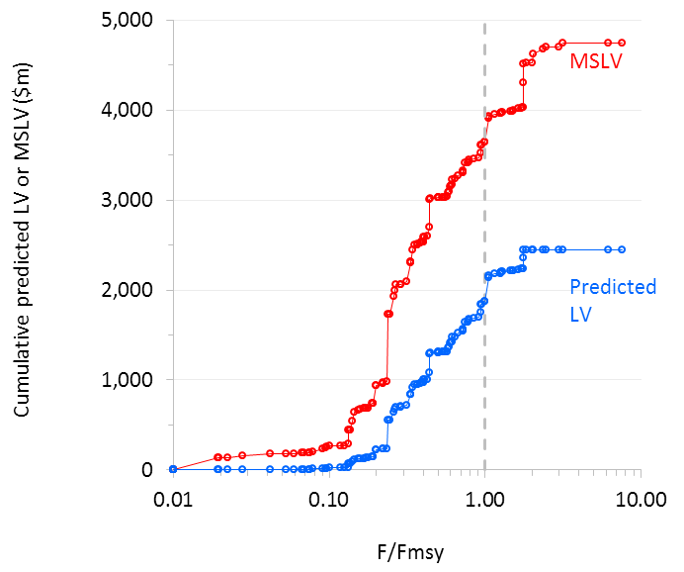
Equilibrium

Slide 16
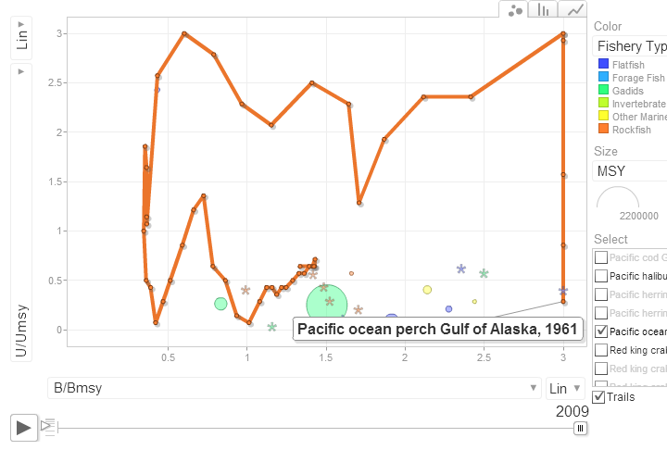
2009
Dynamic stock status plots at: depts.washington.edu/ramlegac
Notes:
Compare current status of several stocks

